Slide 1

Customers’ Buying Journey Analysis
Alissa Dao

Slide 2
Agenda
Project Introduction
Data Wrangling
Exploratory Data Analysis
Implications for stakeholders
Ethical, legal, societal implications
Presentation Title

Slide 3


Project Introduction
ANNUAL REVENUE GROWTH

Slide 4
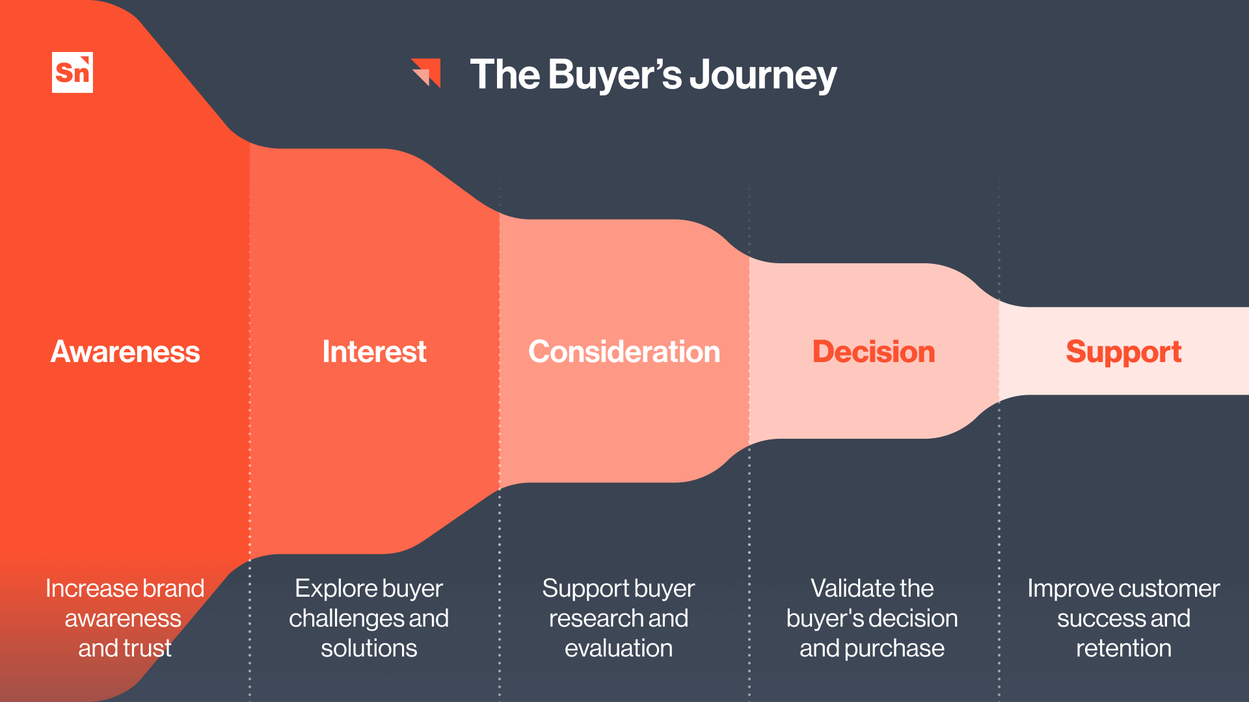
Understanding the influence of different sources of information on Consideration and Purchase (Decision) Stage is essential for a marketing analyst to increase conversion rate

Slide 5
Survey data on customer two-stage decision-making process in household vacuum cleaner market. The dataset contains 1000+ observations. Some key variables are: - Demographic details: Age, Gender, Employment, etc. - Vacuum Cleaner Consideration - Reasons for Vacuum Cleaner Consideration - Vacuum Cleaner Choice - Reason for Vacuum Cleaner Choice For this project: Factors – Sources of Information - Influencing Decision Making

Slide 6
Data Wrangling
ANNUAL REVENUE GROWTH

Slide 7
Main Steps
Checking for Spelling errors
Unpivoting the data
Checking for missing values
Dealing with “Prefer not to say” responses
Checking for Duplicates

Slide 8
Exploratory Data Analysis
ANNUAL REVENUE GROWTH

Slide 9
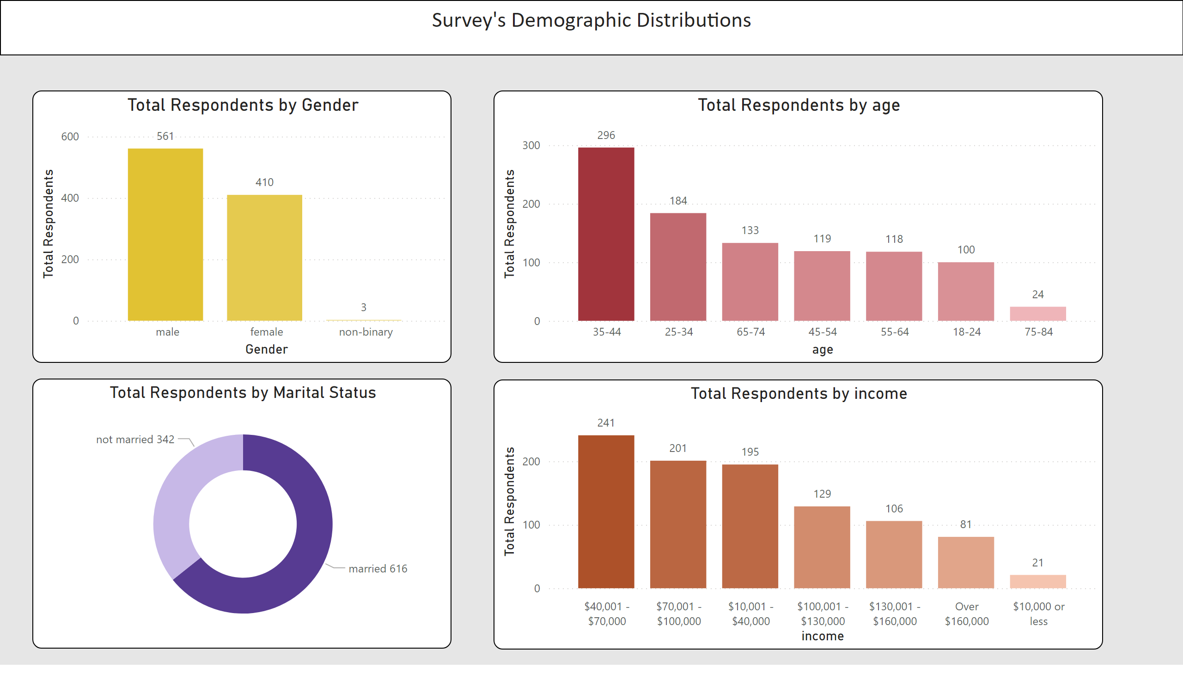
Demographics Distribution

Slide 10
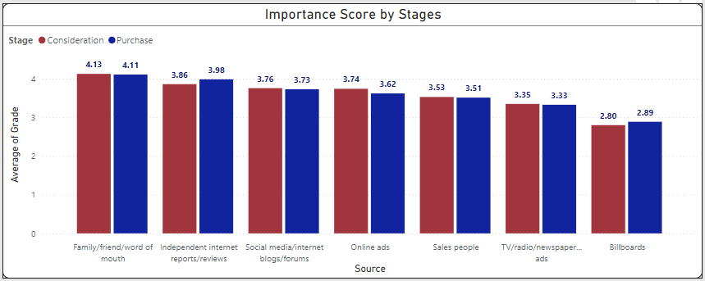

Influence of Information Sources by Demographics
Age: 25 - 34
Age: 35 - 44

Slide 11
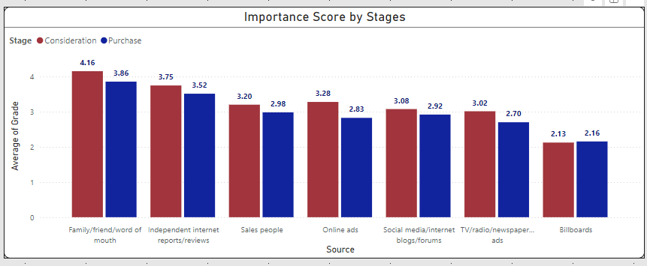
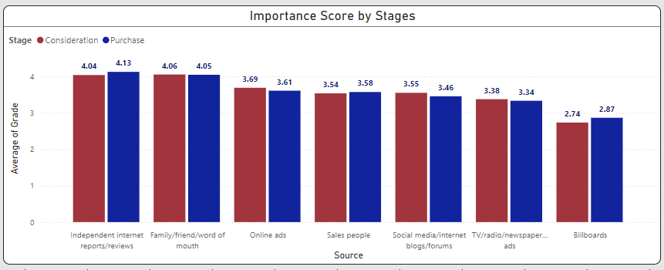
Influence of Information Sources by Demographics
Gender: Female
Gender: Male

Slide 12
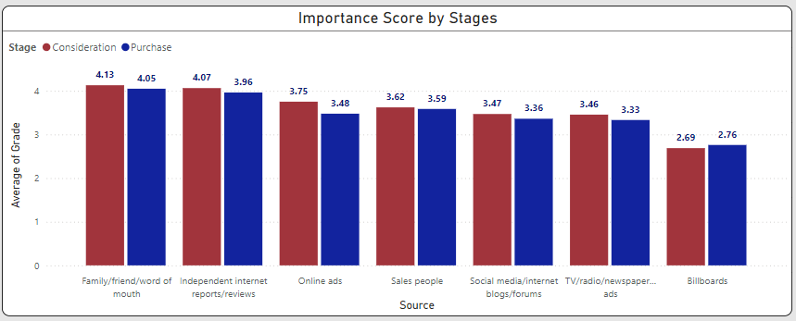
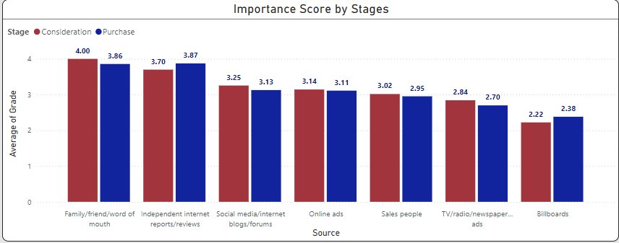
Influence of Information Sources by Demographics
Married
Not Married

Slide 13
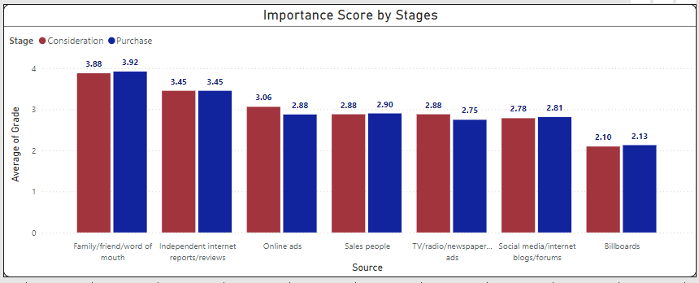

Influence of Information Sources by Demographics
Income Range: $40k - $70k
Income Range: $130k - $160k

Slide 14
Implications for Stakeholders
ANNUAL REVENUE GROWTH

Slide 15





Action
Developing Targeted Campaigns
Influencer and Referral Programs
Enhance post-sale engagement
Channel Optimization
Leverage Customer Testimonials

Slide 16
Ethical, legal, societal implications
ANNUAL REVENUE GROWTH

Slide 17

Ethical Considerations
Discriminatory Practices
Manipulative Marketing Through Online Reviews and Word of Mouth
Marketing should be inclusive
Ethical marketing must prioritize transparency.
Exploitation of Vulnerable Groups
Ensuring value across demographic groups

Slide 18




Thank you

